Slide 1
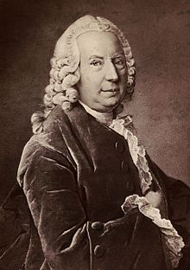
Daniel Bernoulli
Swiss Mathematician and Physicist
February 8, 1700 – March 17, 1782
Pioneer in fluid mechanics, probability and statistics
Bernoulli's principle: equation showing that fluid (e.g. air) pressure falls as fluid velocity increases
Explains airplane wing design
Wikipedia: https://en.wikipedia.org/wiki/Daniel_Bernoulli

