Slide 2
Solar Fusion Mining
Company LLC

Slide 3
Norman Video

Slide 6
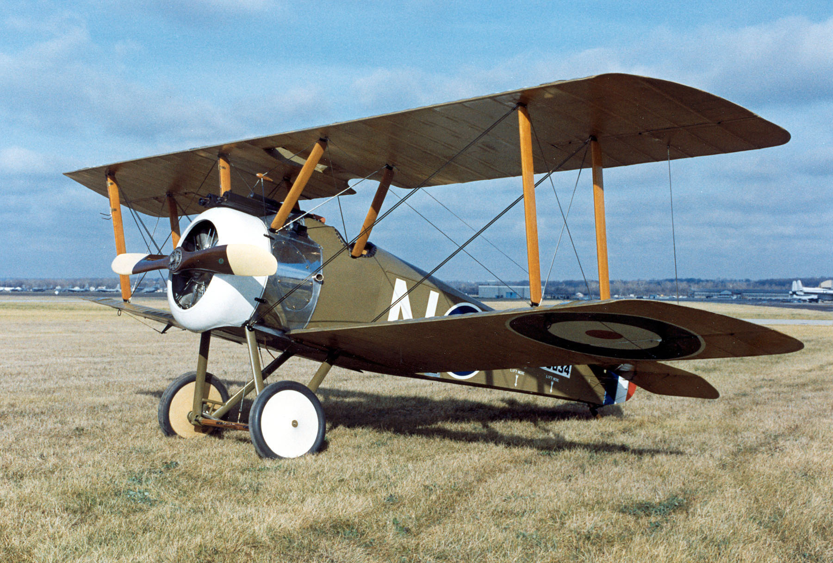

Slide 8
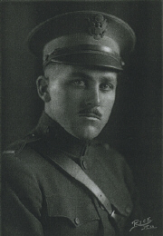
Rodney D. Williams
Wisconsin's First Combat Ace
Born: 01/29/1896, Delafield, Wisconsin
Died: 11/27/1972
World War I: assigned to 17th "American" Aero Squadron, Royal Air Force
July & August 1918: piloted Sopwith Camel fighter in combat over France
Downed four enemy airplanes and one balloon to qualify as Wisconsin's first combat "ace"
Wounded on last mission: landed safely, but hospitalized for rest of war
Wisconsin Aviation Hall of Fame http://www.wisconsinaviationhalloffame.org

Slide 13
Newton's Rings

Slide 14
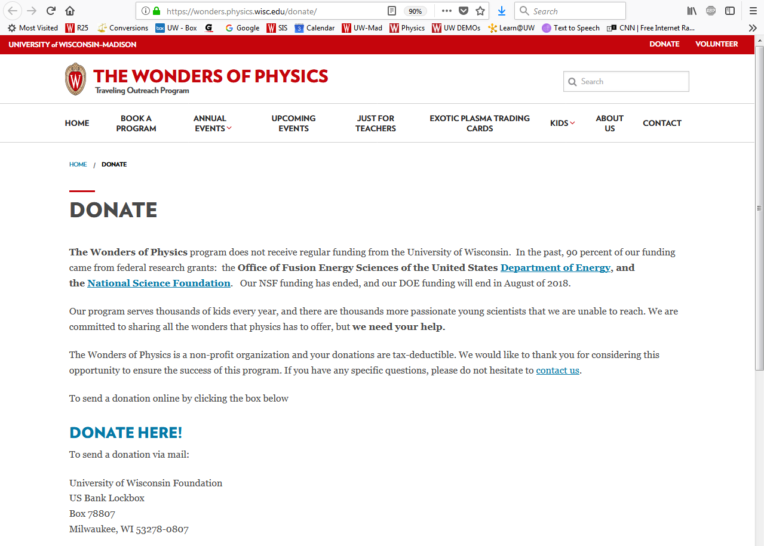
https://wonders.physics.wisc.edu/donate/
`

