Slide 1
The Wonders of
15
P
1
H
39
Y
14
Si
55
Cs
2019
“The Physics of the Elements”

Slide 2
Which element was the first to be man-made artificially?
Zinc (Zn)
Technetium (Tc)
Lutetium (Lu)
Einsteinium (Es)
Tc is also the only element with only radioactive isotopes – none of its isotopes are stable.

Slide 3
After the show…
Visit the Wonders of Physics information table and purchase a t-shirt, DVD, or science toy!
Visit the Ingersoll Physics Museum

Slide 4
What is a “period” in the periodic table of elements?
Elements in the same row
Elements in the same column
The period number of the element describes its highest unexcited electron energy level.

Slide 5
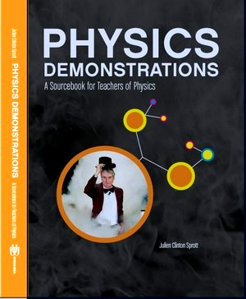
Physics Demonstrations: A sourcebook for teachers of physics
Professor Clint Sprott’s book is a great resource for any science teacher
It contains detailed descriptions of 85 physics demonstrations used in The Wonders of Physics
Videos for the demonstrations are online at: http://physicsdemonstrationsvideos.com
It is available on amazon.com for $49.95

Slide 6
ANNOUNCEMENT
Professor Craney will be holding a lecture on time travel that will be held two weeks ago.

Slide 7
Who is known as the “Father of the Periodic Table”?
Albert Einstein
Galileo Galilei
Ernest Rutherford
Dmitri Mendeleev
In 1906, he came within 1 vote of receiving the Nobel Prize for his work in this area.

Slide 8
Donations are welcome!
Donations help us continue to present The Wonders of Physics year after year!
Donation bins are located outside of the lecture room
Donate online! Visit wonders.physics.wisc.edu and click the Donate tab

Slide 9
When were radioactive elements first discovered?
1775
1886
1901
1812
Antoine Bequerel first discovered radioactivity. The unit of measurement for radioactivity is named after him because of this.

Slide 10
Don’t miss the physics fair!
Hands-on activities and lab tours
Meet scientists and students
Free and open to the public. No tickets required.
http://wonders.physics.wisc.edu/physics-fair.htm
Saturday, February 16th
from 11 am to 4 pm

Slide 11
There are two types of people in this world:
1. Those who can extrapolate from incomplete data.

Slide 12
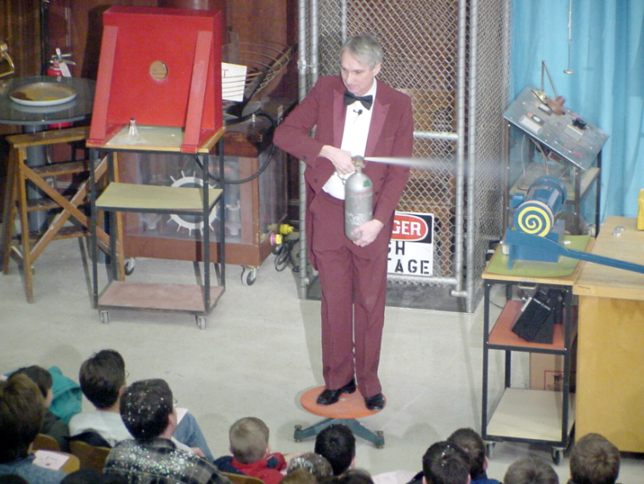
The Wonders of Physics shows are available on DVD and online!
Order any of the past 35 years of shows on DVD, or order the whole set!
Click the Gallery tab on our website to watch all of the past shows online
DVDs are available at the Wonders of Physics information table

Slide 13
Most of the elements in the periodic table are…
Gases
Semiconductors
Metals
Liquids
The alkali metals, alkaline earths, basic metals, transition metals, lanthanides, and actinides are all types of metals.

Slide 14
Funding support
Please visit http://wonders.physics.wisc.edu and click the Donate tab to find out how you can make a difference!

