Slide 1

Stretched String
FIGURE 1
L is the strong length.
λ is the wavelength: the distance of a full repetition of the pattern.
The full line is the height of the string at a some particular time t₁.
The dashed lines are at each at fixed later times, t₂, t₃, etc.

Slide 2
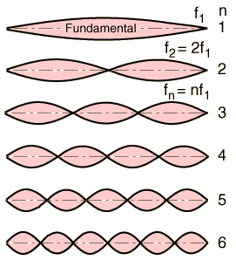
STANDING WAVES

Slide 3
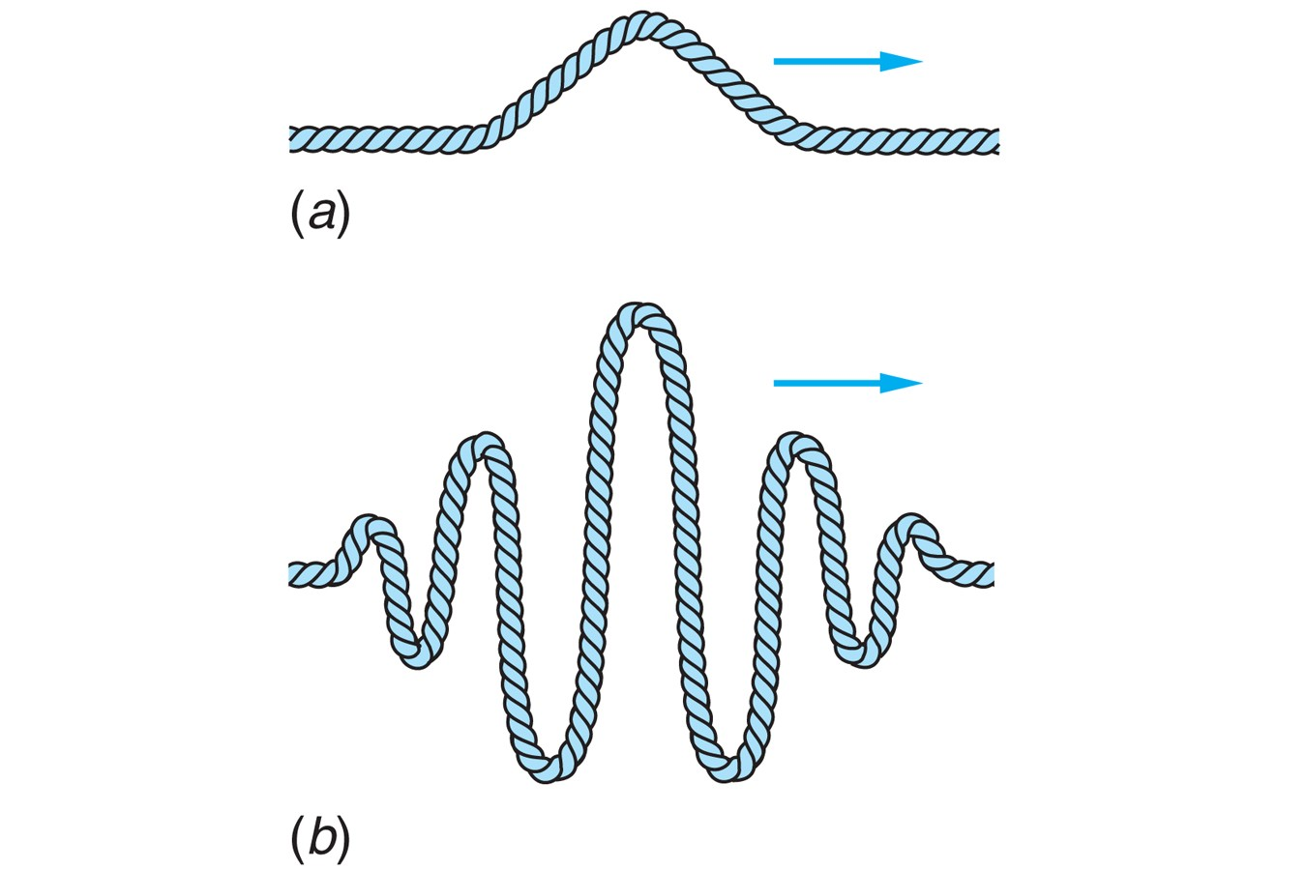
TRAVELING WAVES

Slide 4
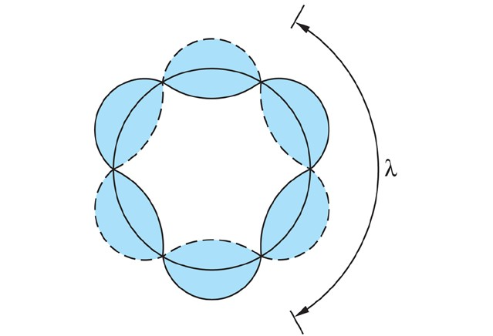
CLOSED STANDING WAVE

Slide 5
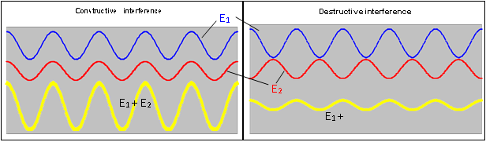
INTERFERENCE

Slide 6
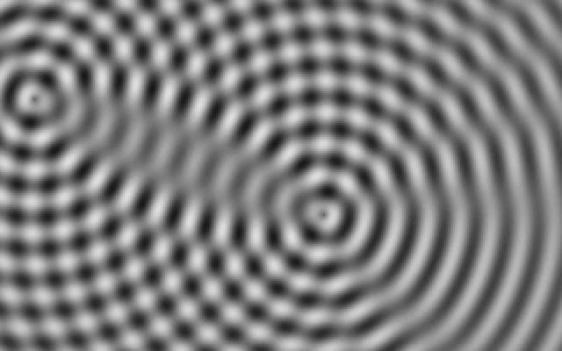
INTERFERENCE

Slide 7
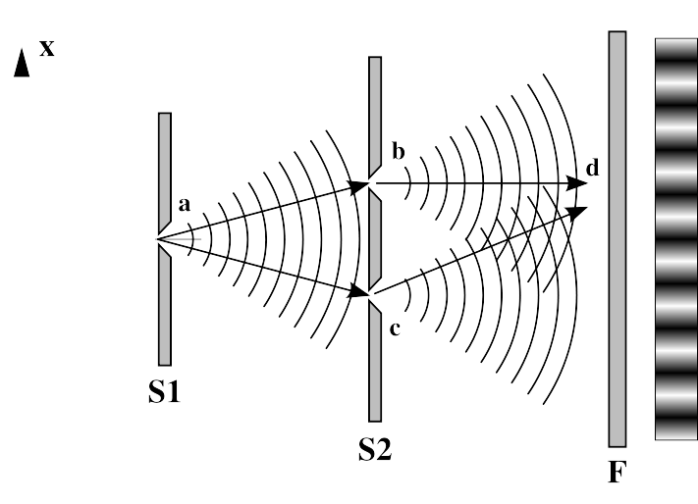
DOUBLE-SLIT EXPERIMENT

Slide 8
WAVEPACKETS

Slide 9
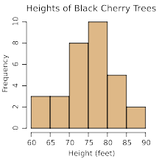
HISTOGRAMS

Slide 10
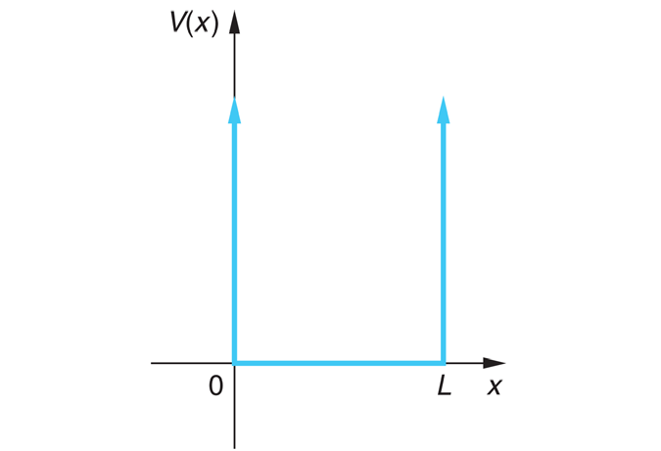
SQUARE WELL

Slide 11
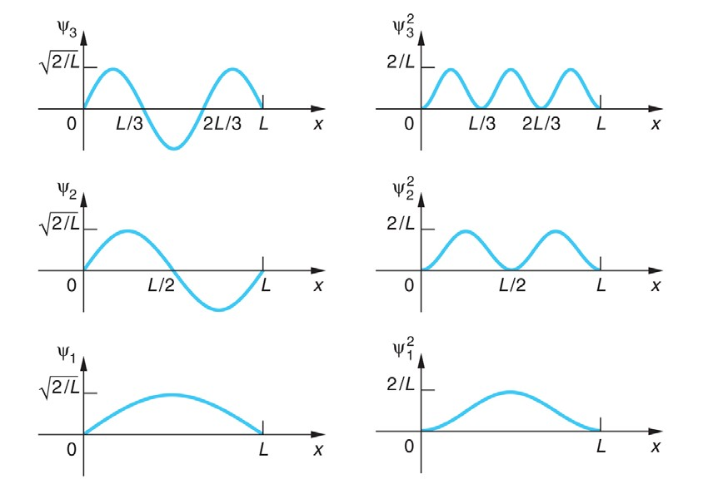

Slide 12
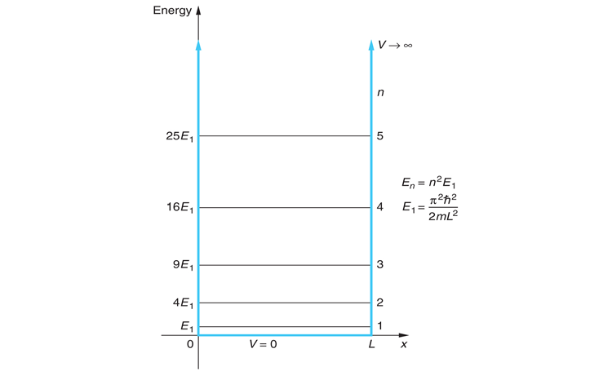

Slide 13
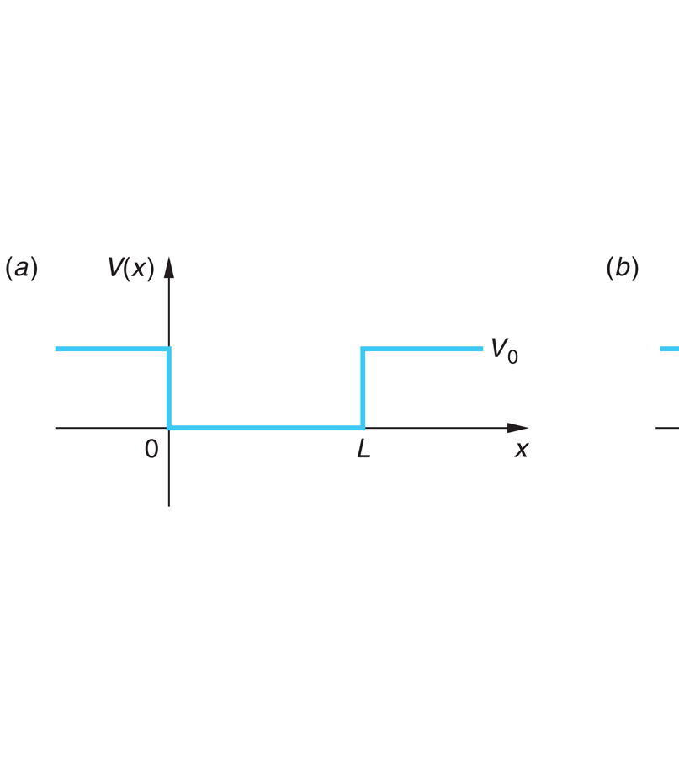

Slide 14
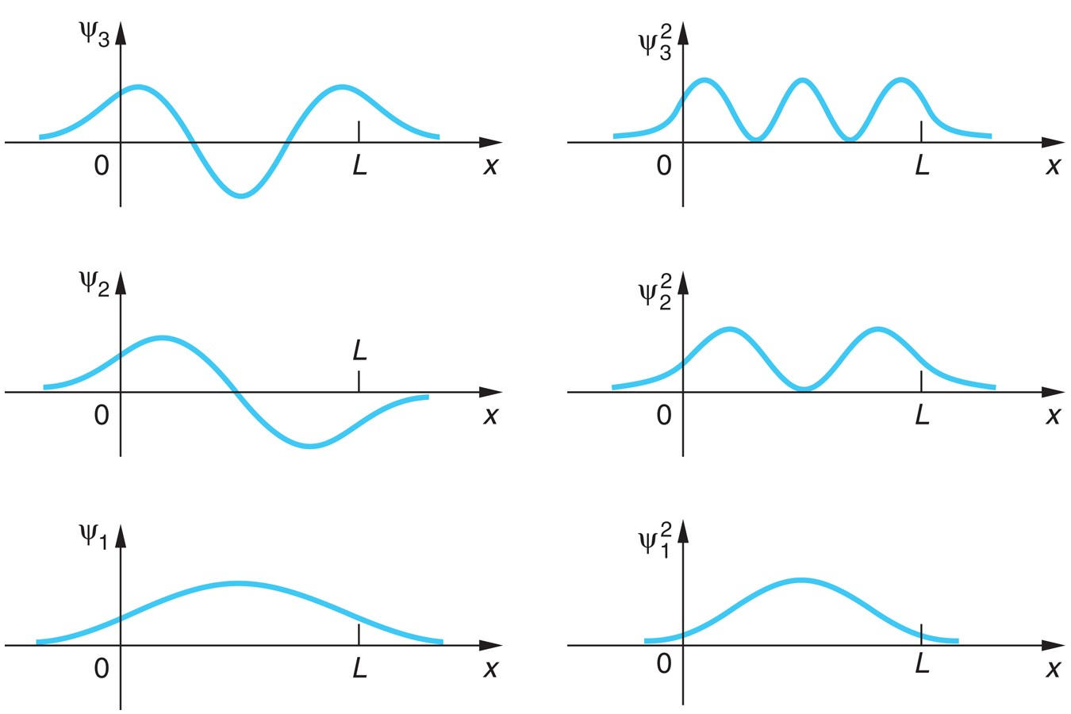

Slide 15
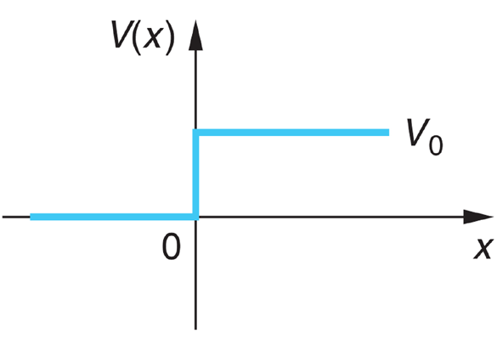

Slide 16
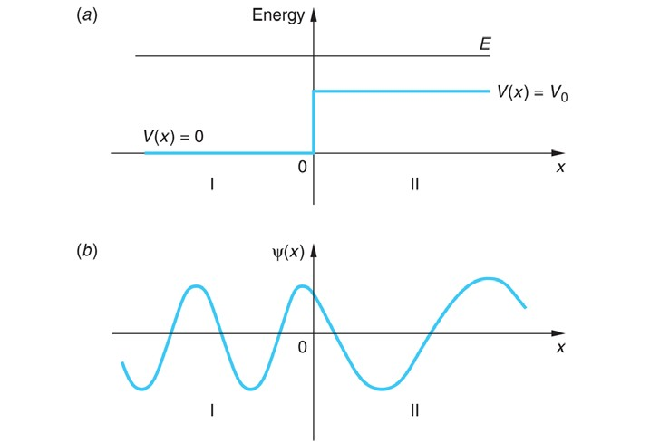

Slide 17
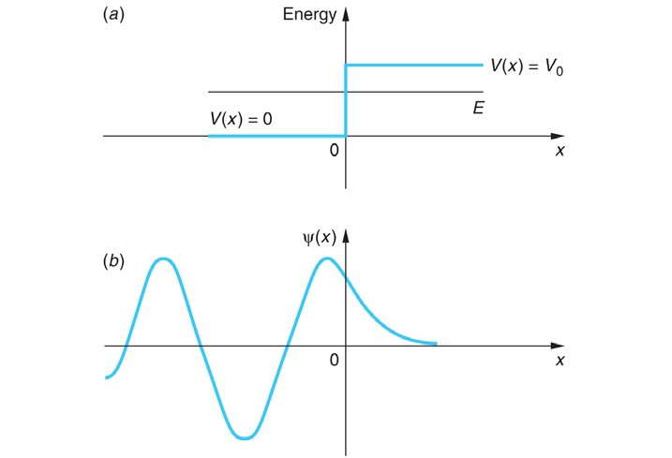

Slide 18
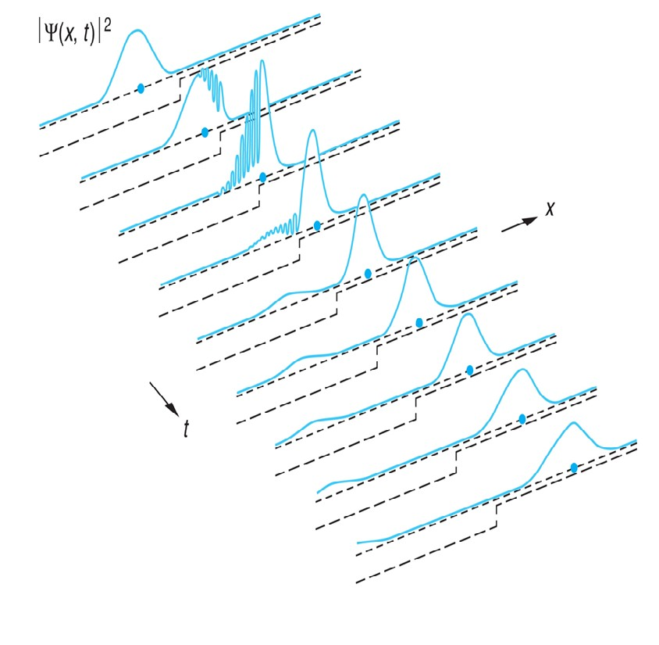

Slide 19
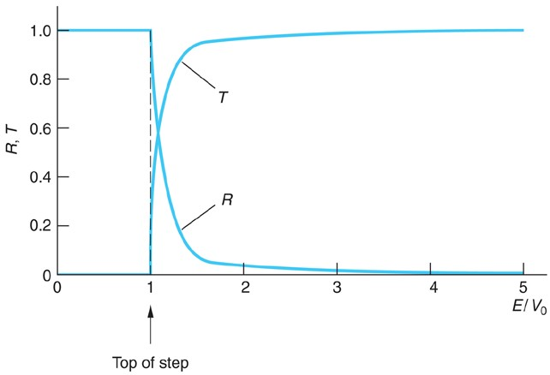

Slide 20
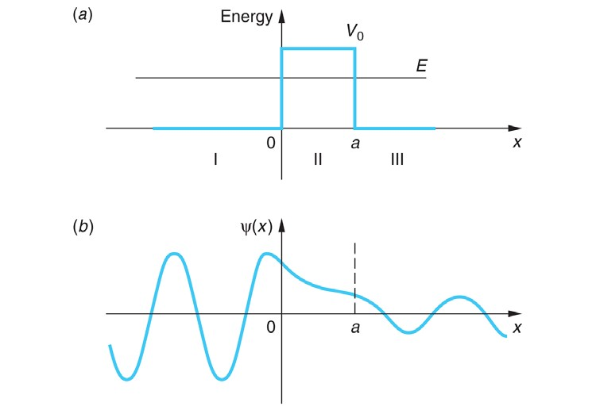

Slide 21
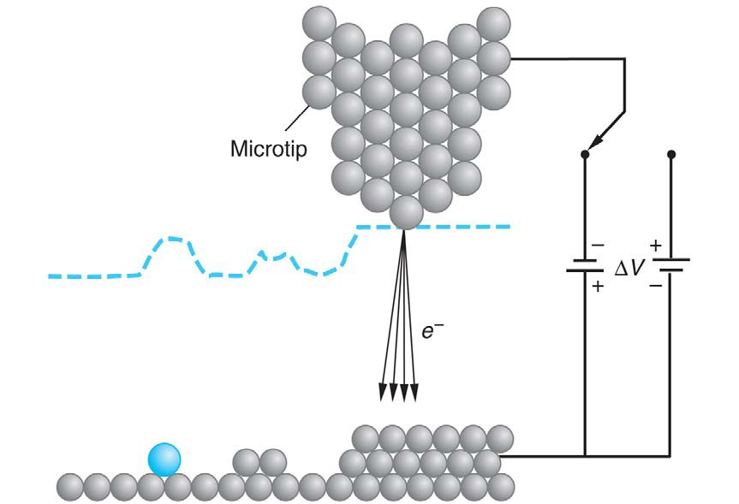

Slide 22
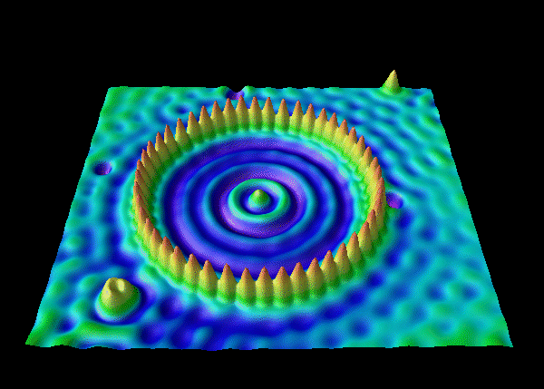

Slide 23
ENERGY LEVELS AND TRANSITIONS IN THE H ATOM

Slide 24
BOUND STATES AND UNBOUND STATES IN THE
COULOMB POTENTIAL OF THE H ATOM

Slide 25
SPHERICAL COORDINATES

Slide 26
ELECTRON CLOUDS FOR SOME HYDROGEN STATES

Slide 27
RADIAL PROBABILITIES FOR SOME STATES OF THE H ATOM

Slide 28
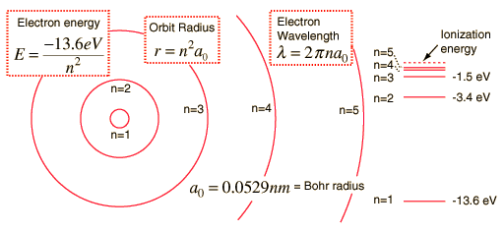
SUCCESSIVE STATES IN THE H ATOM

Slide 29
STERN-GERLACH EXPERIMENTAL APPARATUS

Slide 30
STERN GERLACH EXPERIMENTAL RESULTS

Slide 32
ENERGY LEVELS IN MANY-ELECTRON ATOMS

Slide 33
IONIZATION ENERGIES OF THE ELEMENTS

Slide 35
VELOCITY COMPONENT DISTRIBUTION FUNCTION

Slide 36
VELOCITY MAGNITUDE DISTRIBUTION FUNCTION

