Slide 3
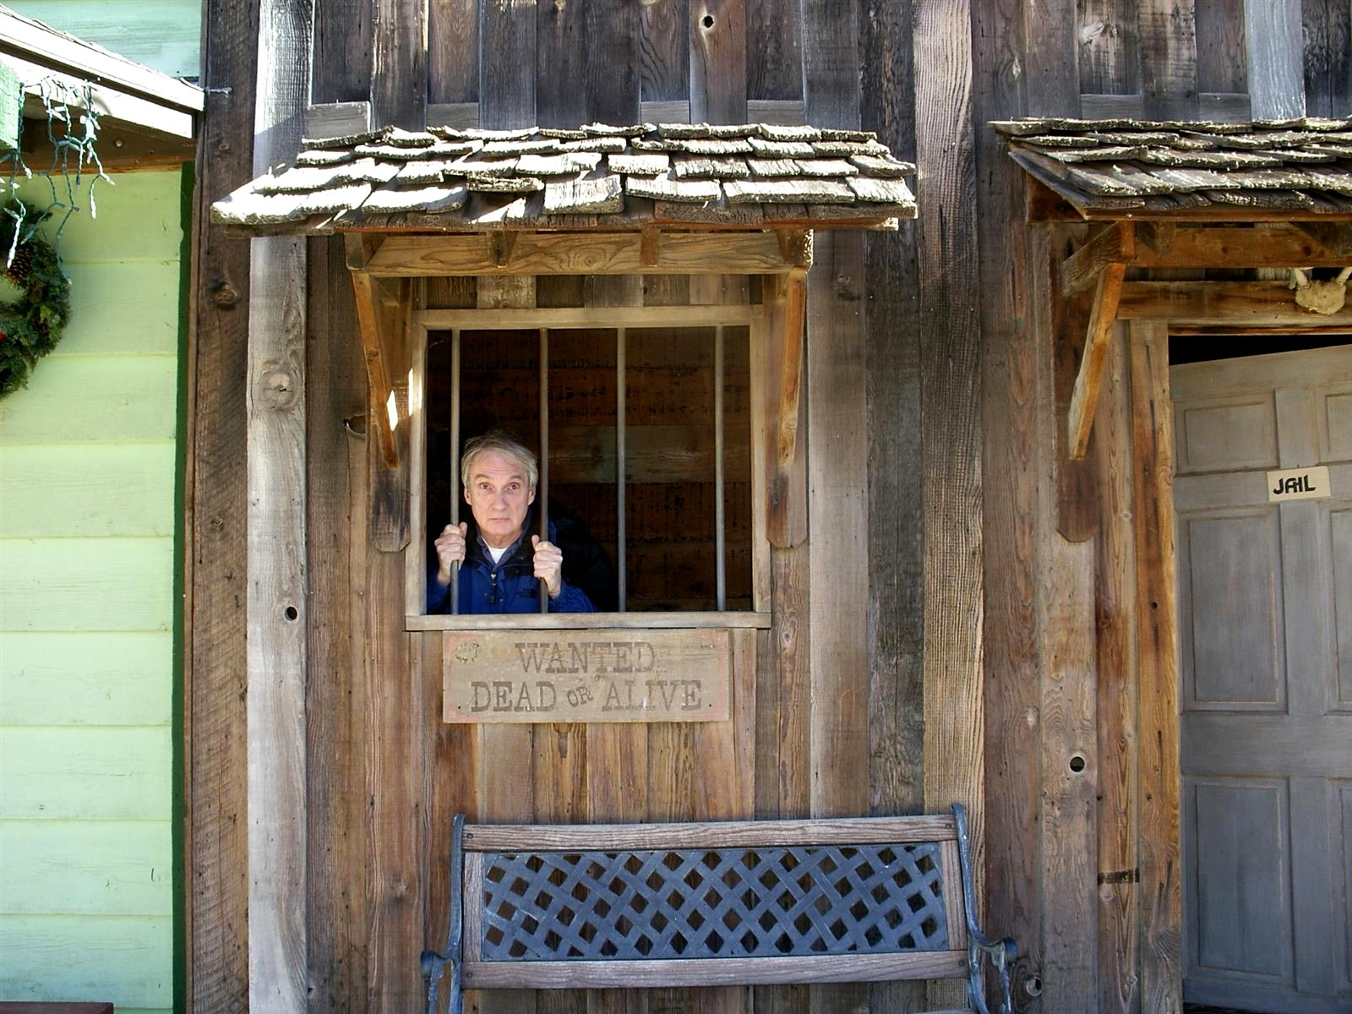

Slide 5
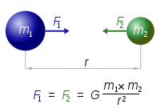
Breaking Newton’s Law of Gravity
Newton's Second Law of Motion:
The relationship between an object's mass m, its acceleration a, and the applied force F is F = ma.
The force is proportional to the product of the masses and inversely proportional to the square of the distance between them.
F = G[ {m1 m2} / {r^2} ],

Slide 9
Non-Newton Fluid

Slide 11
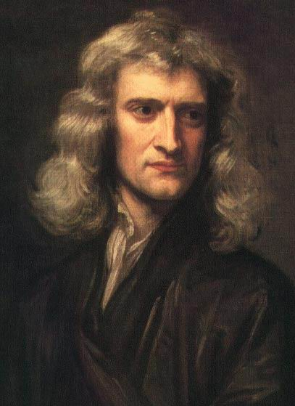
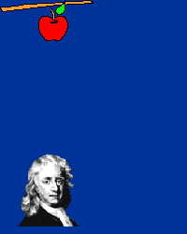
Newton's First Law of Motion:
Every object in a state of uniform motion tends to remain in that state of motion unless an external force is applied to it. (The Law of Inertia)
Newton's Second Law of Motion:
The relationship between an object's mass m, its acceleration a, and the applied force F is F = ma.
Newton's Third Law of Motion:
For every action there is an equal and opposite reaction.
Sir Isaac Newton (1643-1727) Age 84
A Newton is the measure of Force: 1N = 1 (kg m) / s²

Slide 13
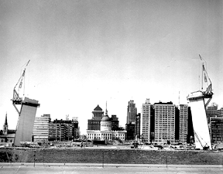
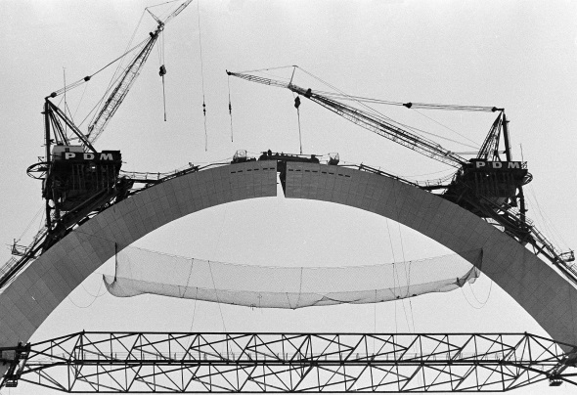
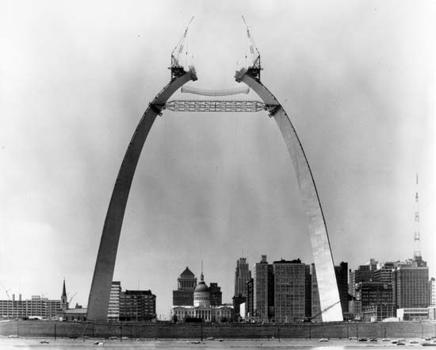
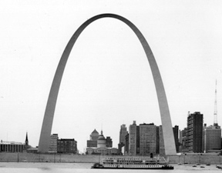
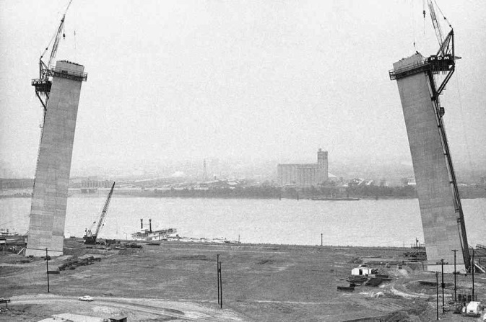
St. Louis Arch
Keystone being placed
Construction progress
Construction began in 1963
Completed in 1965

Slide 15
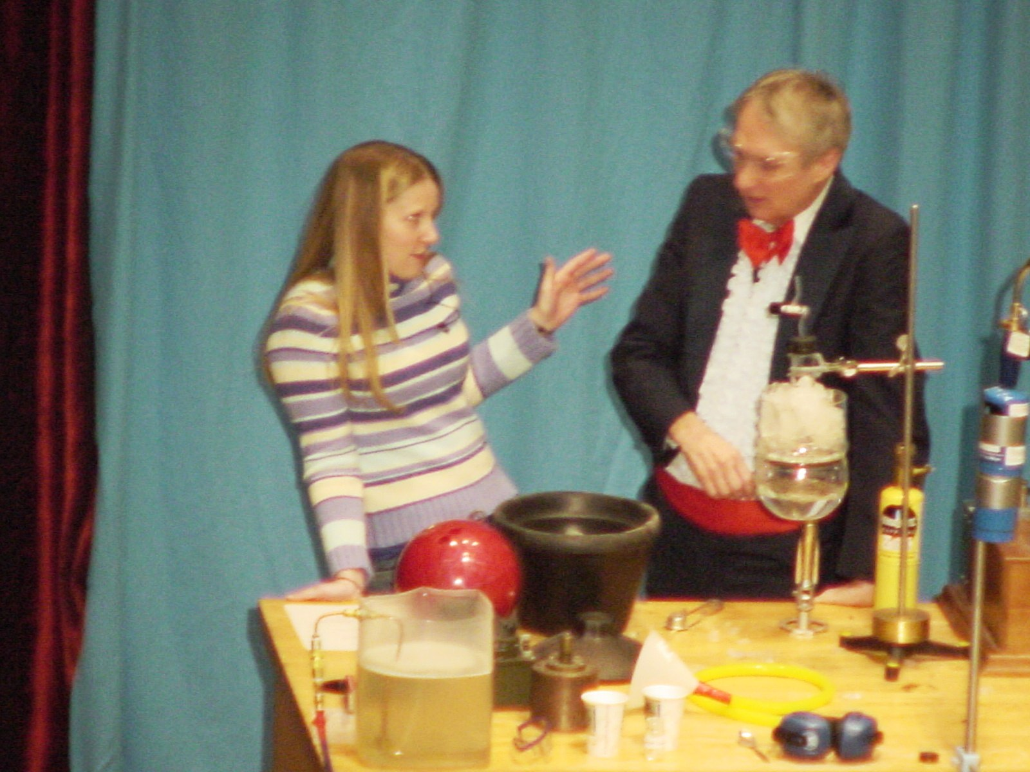

Slide 16
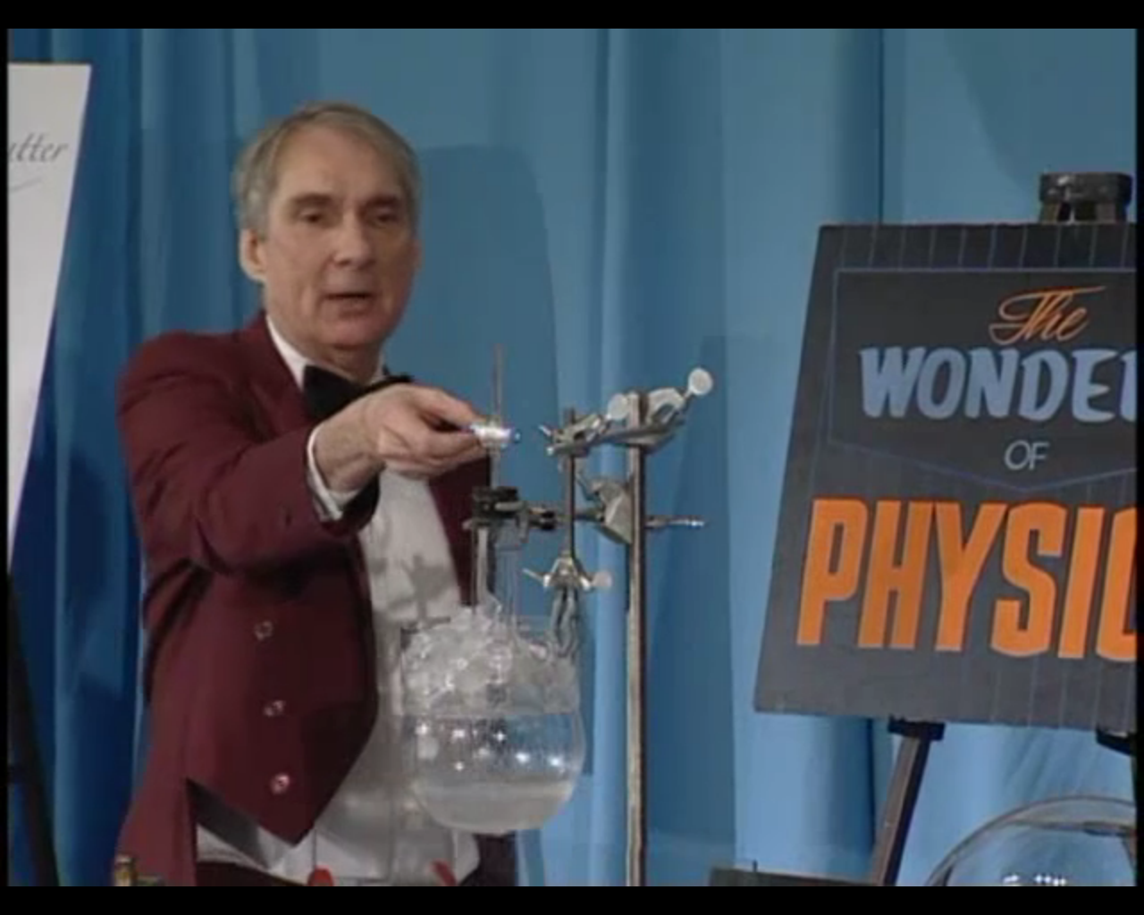

Slide 18
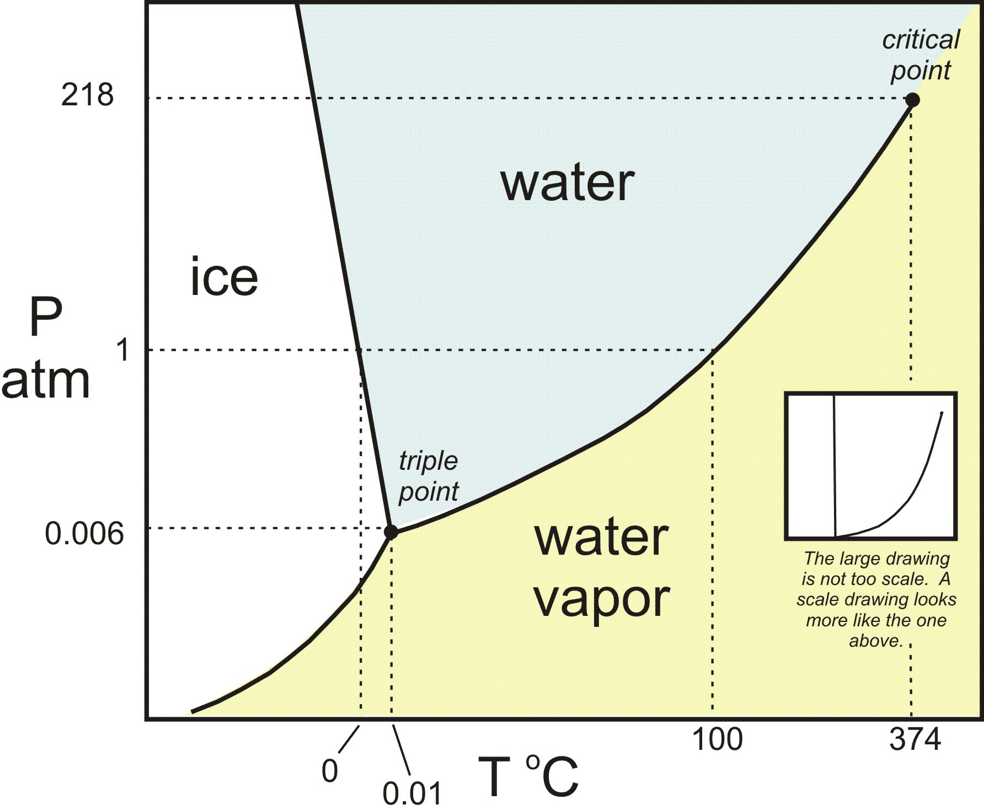
Christian Andreas Doppler
Christian Andreas Doppler

Slide 20
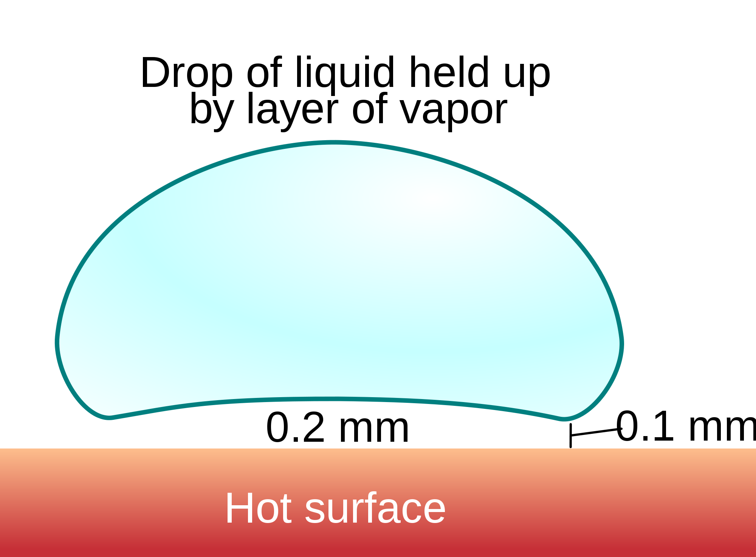

Slide 24
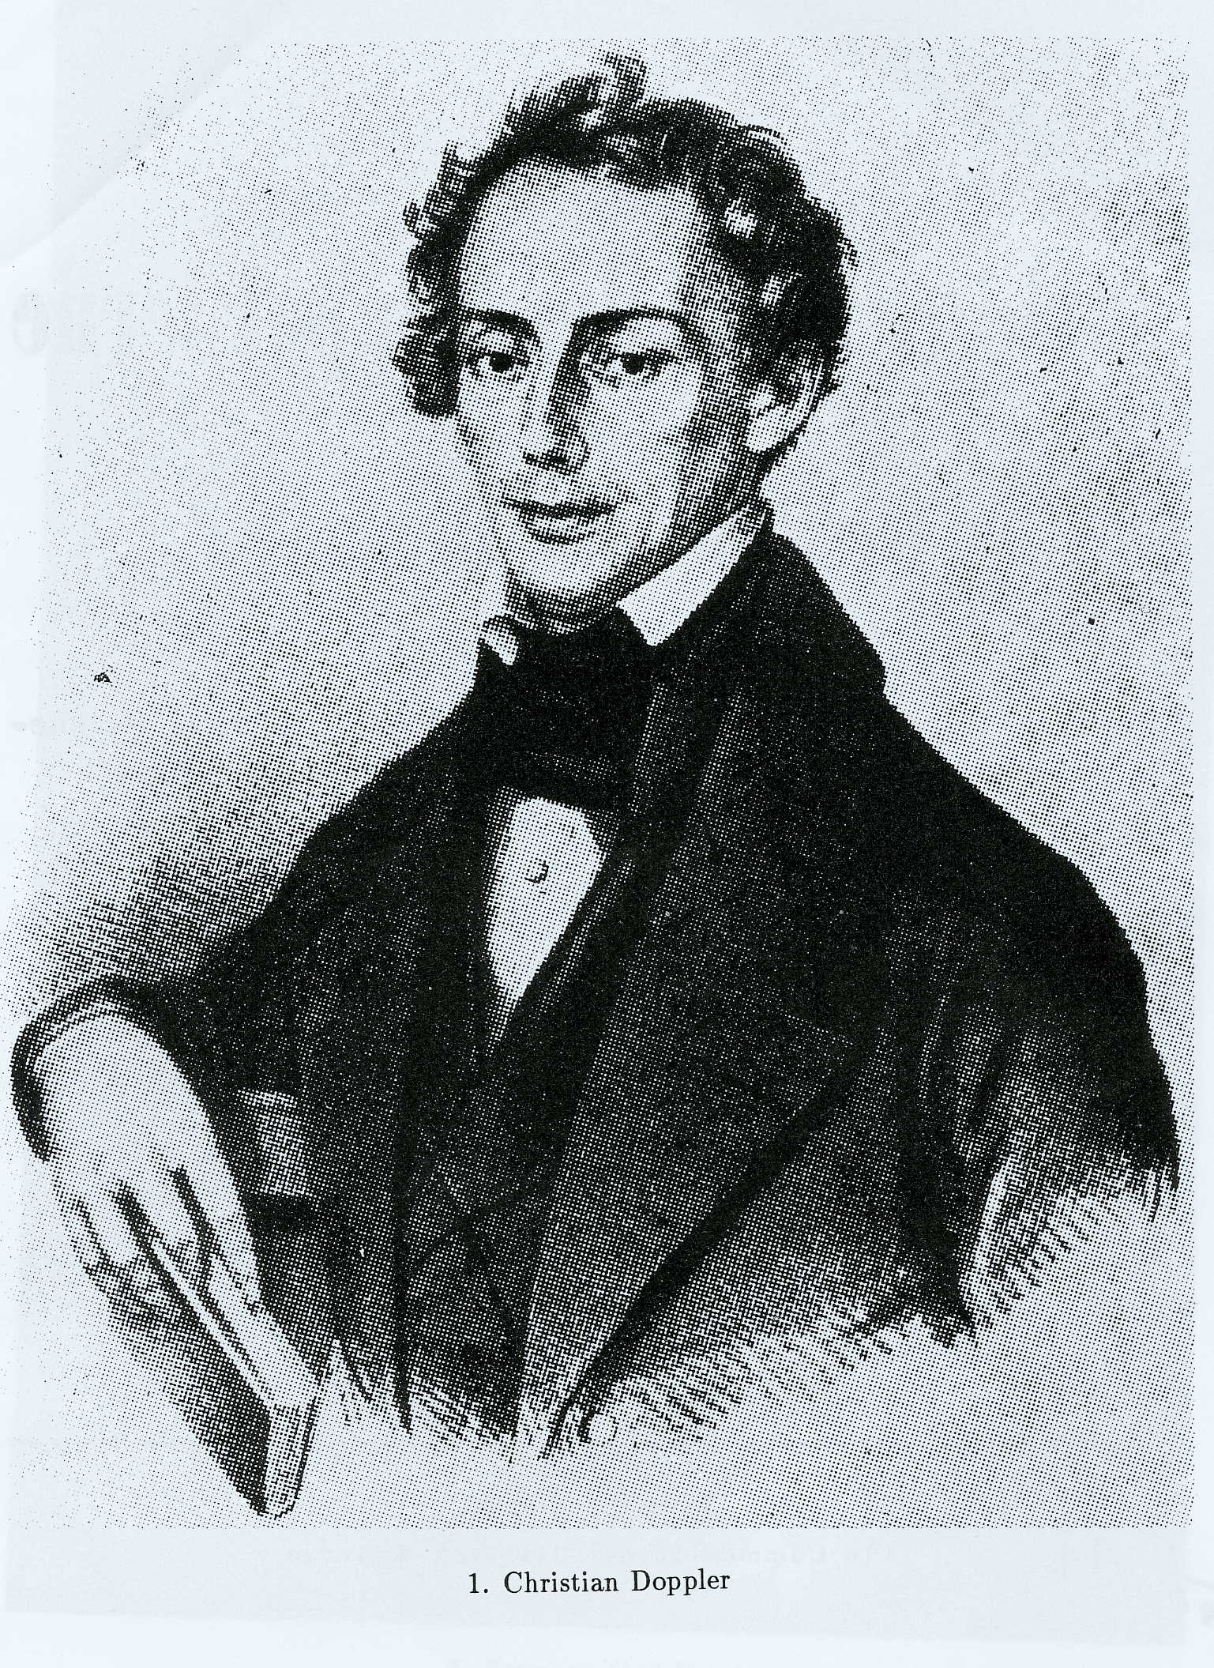
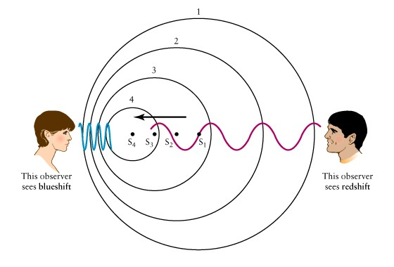
An Austrian mathematician and physicist. Most famous for what is now called the Doppler effect. Proposed in 1842, the apparent change in frequency and wavelength of a wave as perceived by an observer moving relative to the wave's source.
The perceived frequency is higher during the approach and it is lower during the recession.
Christian Doppler (1803-1853) Age 49

Slide 25
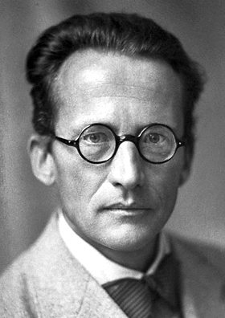
Famous for his Time-dependent and Time-independent equations. His cat is also famous.
Erwin Schrödinger (1887 – 1961) Age 73

Slide 27
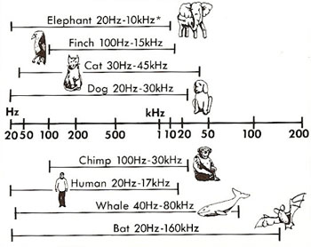

Slide 29
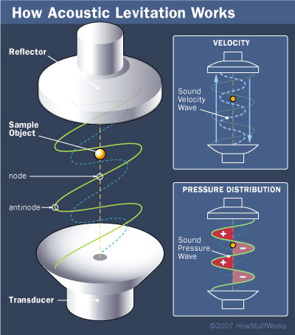

Slide 31
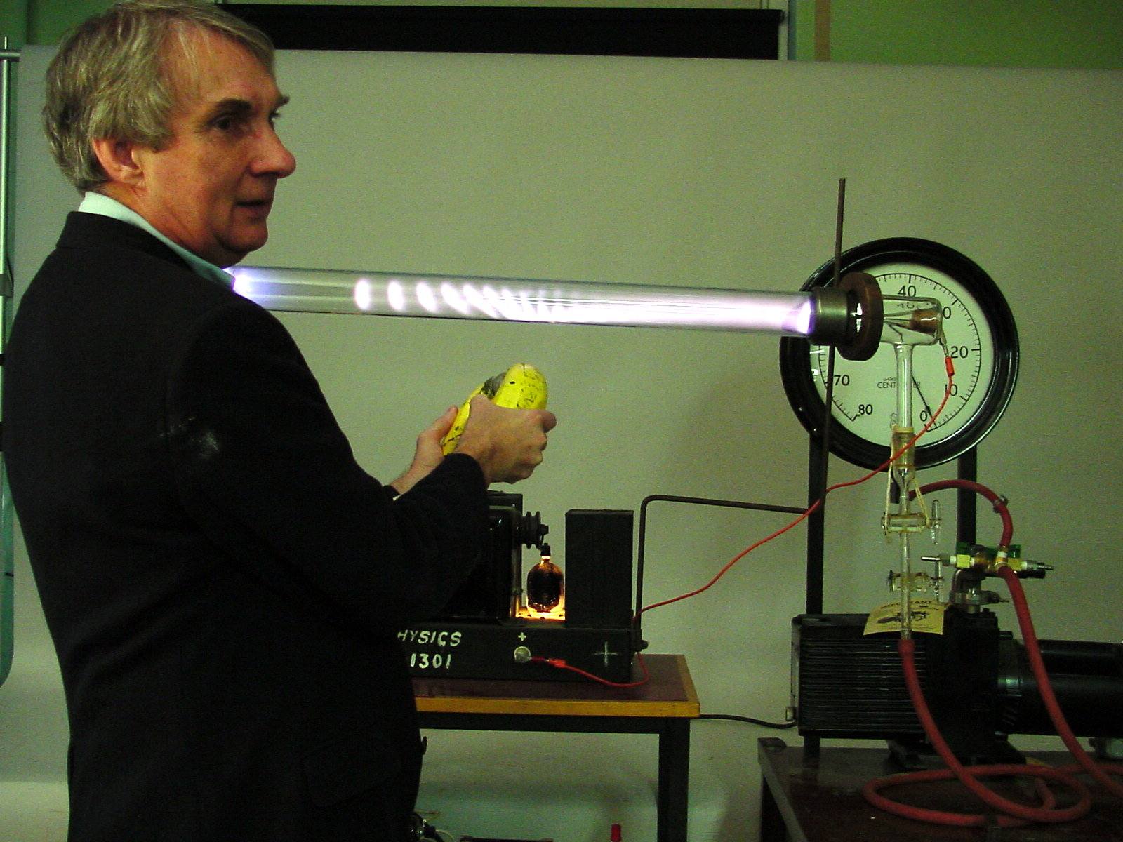
Christian Andreas Doppler
Christian Andreas Doppler

Slide 33
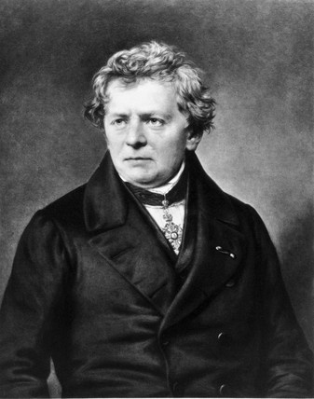
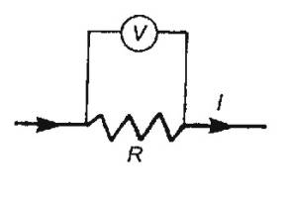
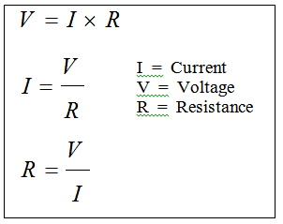
Known for discoveries in electricity and magnetism
Found the relationship between the a current and the voltage, now known as Ohm’s Law
Georg Simon Ohm (1789 – 1854)

Slide 35
Known for work in electricity and magnetism
Known for contributions in electricity and magnetism
Worked with tuned circuits using high-voltage and high-frequency resonant transformers
Nikola Tesla (1856-1943)

Slide 37
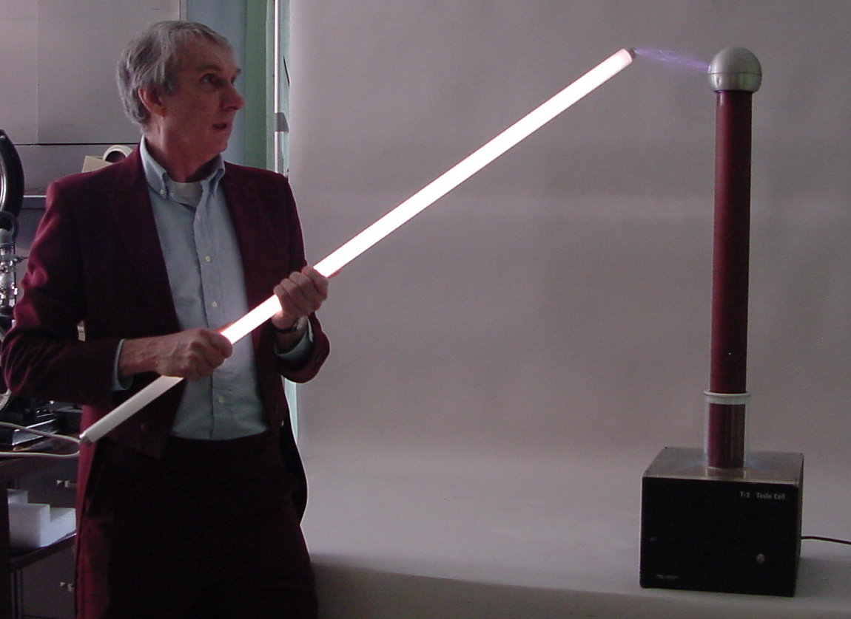
Christian Andreas Doppler
Christian Andreas Doppler

Slide 39
Lorentz

Slide 41
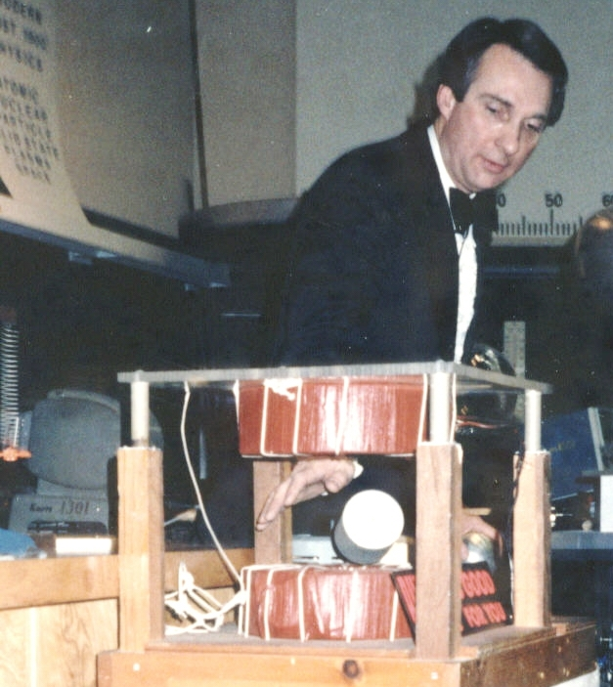
Christian Andreas Doppler
Christian Andreas Doppler

Slide 43
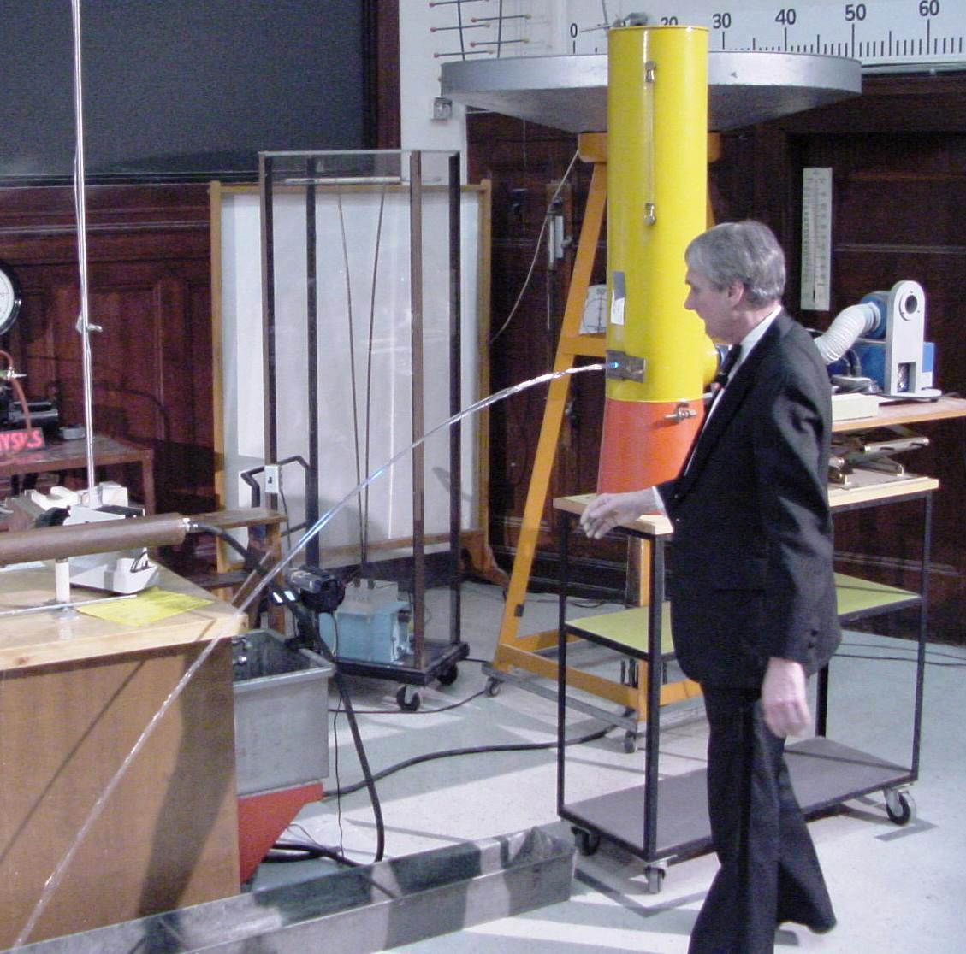

Slide 45
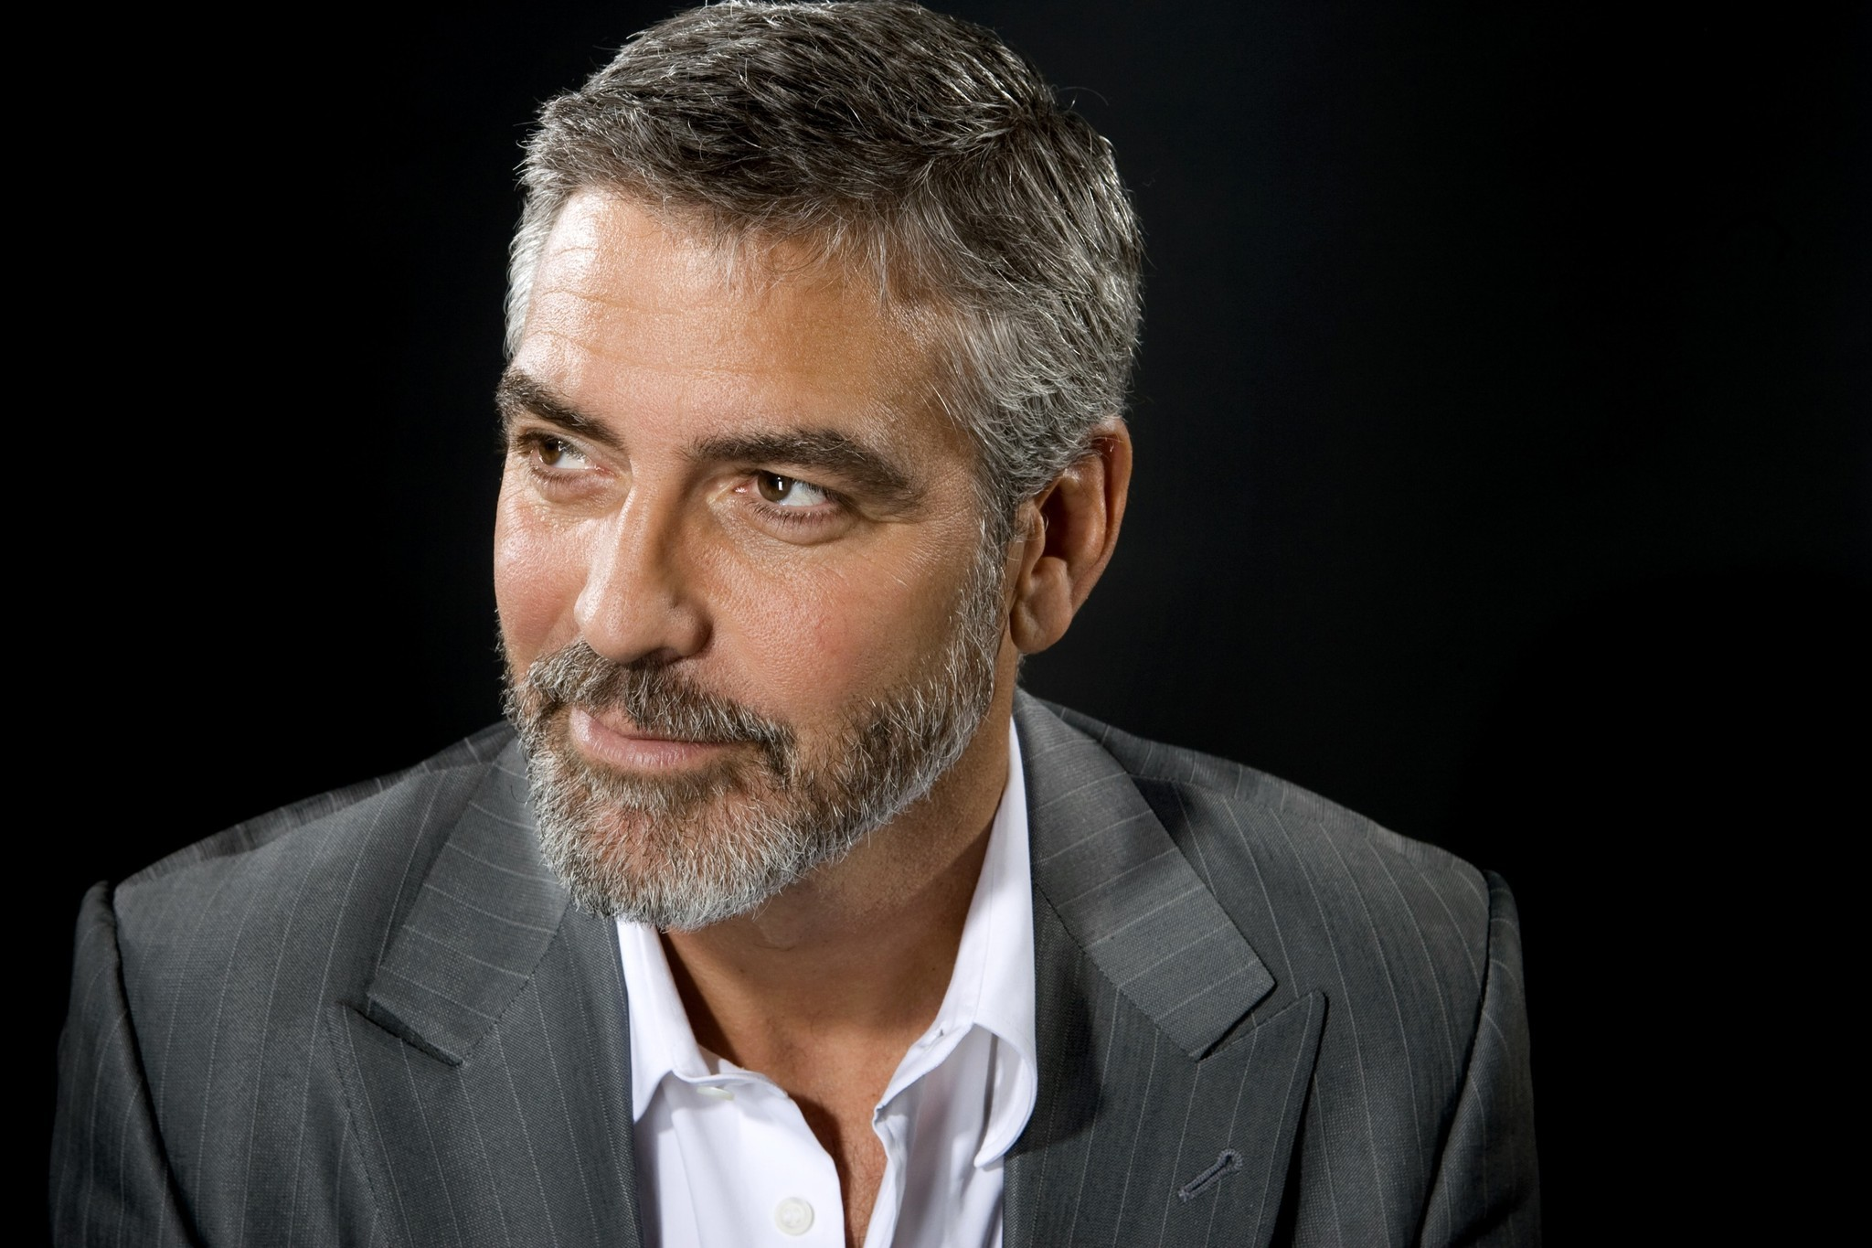
George Clooney

Slide 49
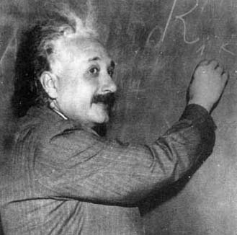
Best known for his theories of special and general relativity
One commonly used application is GPS
Predictions of relativity:
Gravitational lensing
Time dilation
Length contraction
Christian Andreas Doppler
Christian Andreas Doppler
Albert Einstein (1879-1955)

Slide 50
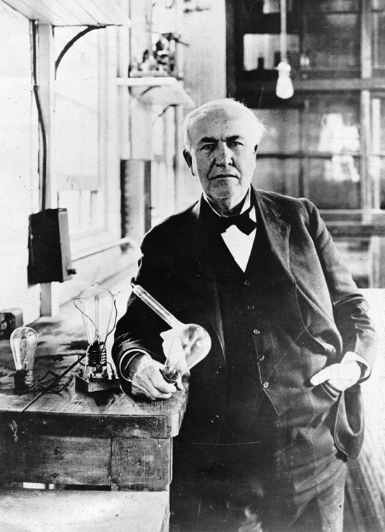
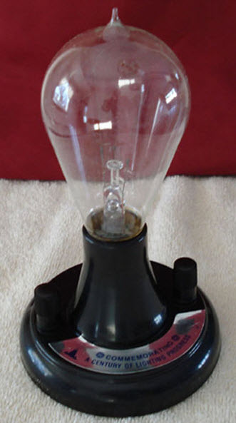
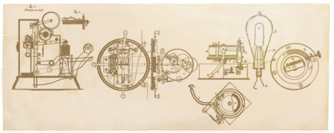
In 1878, Edison formed the Edison Electric Light Company in New York City with several financiers
Edison patented a system for electricity distribution in 1880, which was essential to capitalize on the invention of the electric lamp.
On February 11, 2011. Google Doodle Honors
Thomas Edison's 164th Birthday
Thomas Edison (1847-1931) Age 84

Slide 51
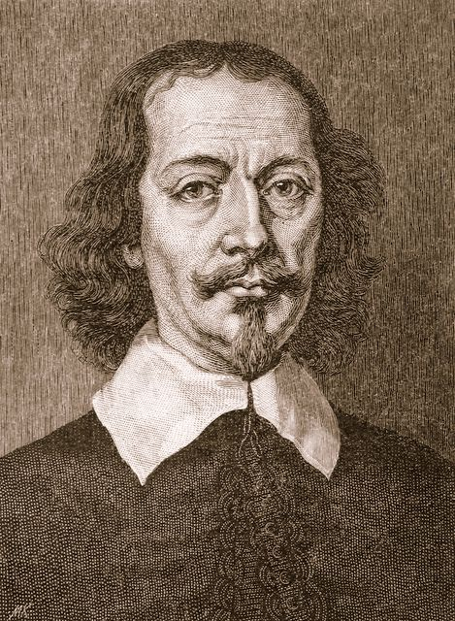
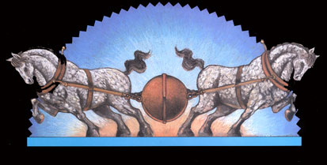
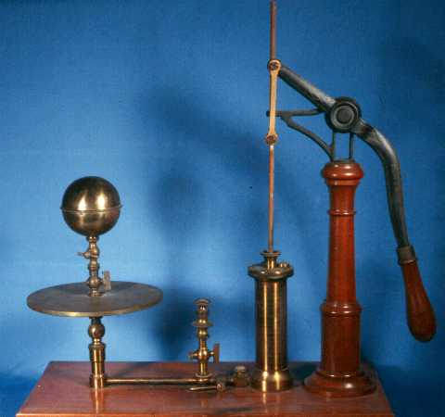
He served as the mayor of Magdeburg, Germany from 1646 to 1676.
In 1650 he invented a type of vacuum pump consisting of a piston and an cylinder with two-way flaps to pull air out of whatever vessel it was connected to.
Otto Von Guericke (1602-1686) Age 83

Slide 52
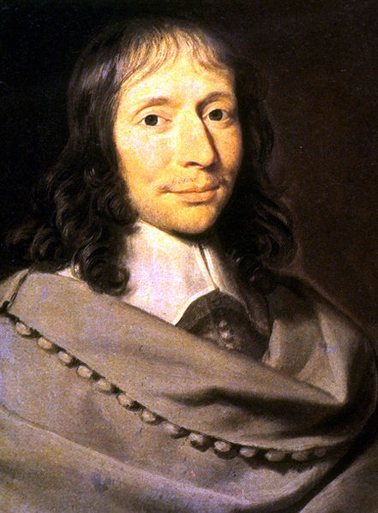
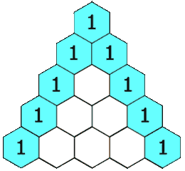
Pascal's law or Pascal's principle “Pressure exerted anywhere in a confined fluid is transmitted equally and undiminished in all directions throughout the fluid.”
Pascal continued to influence mathematics throughout his life. In1653 he described a convenient tabular presentation for binomial coefficients, now called Pascal's triangle.
Blaise Pascal (1623-1662) Age 39
Standard Atmosphere = 101.325 kPa

Slide 53
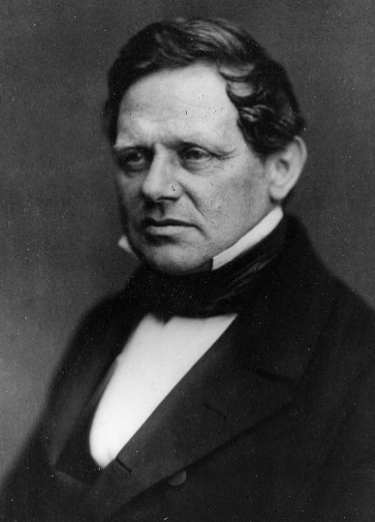
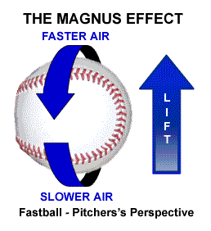
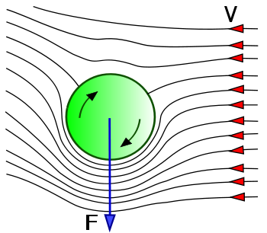
The Magnus effect is a principle of fluid dynamics that describes the lift created by the spin of an object that is moving through a fluid (gas or liquid).
Heinrich Magnus (1802-1870) Age 67

Slide 54
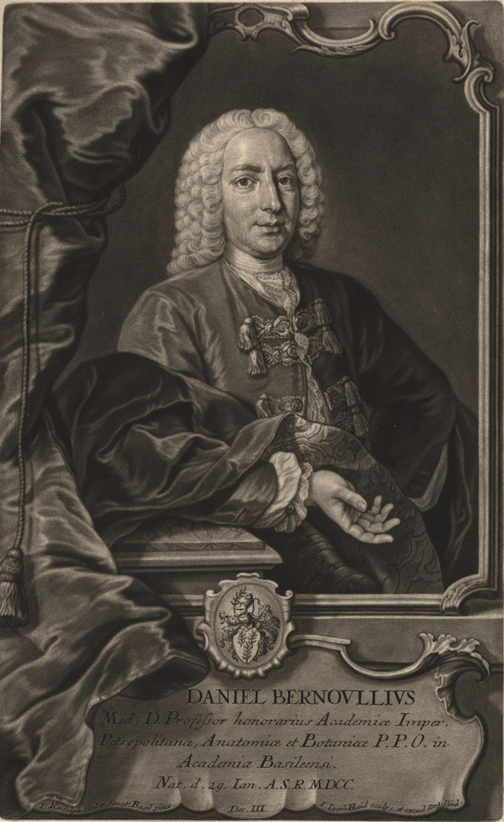
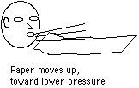
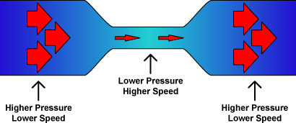
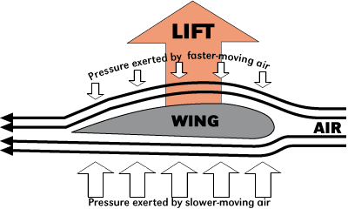
Was a Dutch-Swiss mathematician. He is remembered for his applications of mathematics to mechanics, especially fluid mechanics, and for his pioneering work in probability and statistics.
Bernoulli's Principle
Daniel Bernoulli (1700-1782) Age 82
Bernoulli's Equation:

Slide 55
