Slide 1
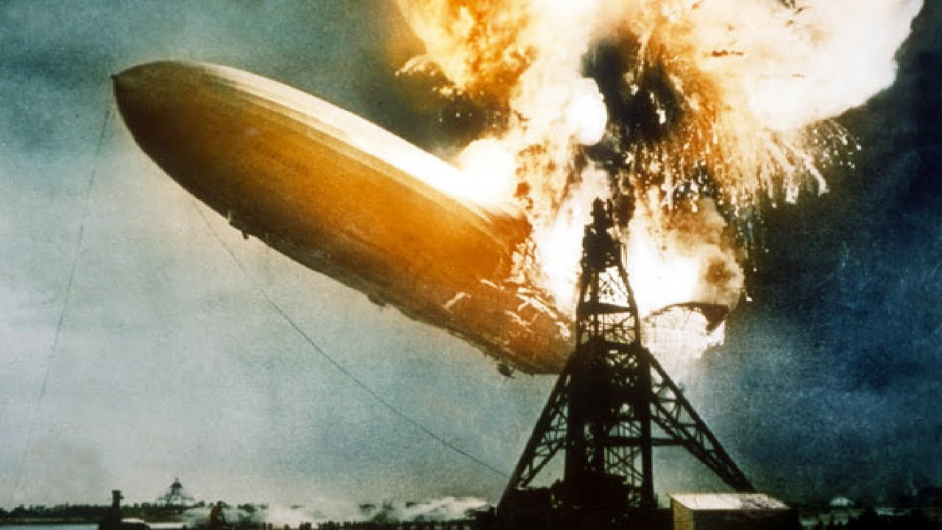
Helium=Not Flammable
Hydrogen=Flammable

